Slide 1
LINK
GROUP
LINK
Automation Engineering (Shanghai) Co.,Ltd.
GROUP
霖和自动化工程(上海)有限公司
Training Record
Staff name: Nguyễn Tuấn Phong ( Assistant PLC Engineer)
Mainly training: SOFTWARE STRUCTURE
General information
Structure
Operating Modes
Programming Specification

Slide 2
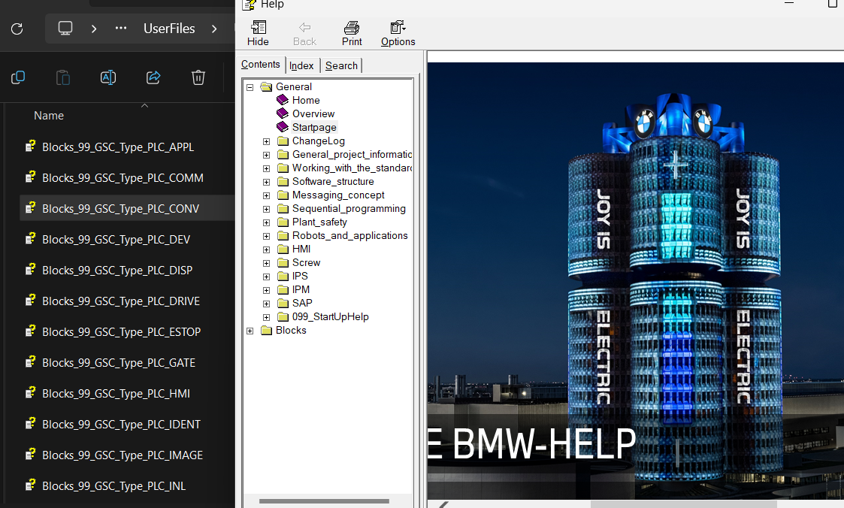
LINK
General information
GROUP
For support, the GSC standard offers its own help,
where we can find information on blocks, the
software structure and other standard
specifications.
We can find the help in the project directory under:
…\ UserFiles \ UserDocumentation \en-US.

Slide 3
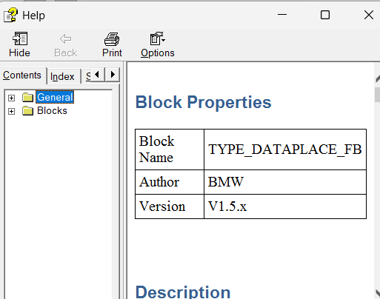
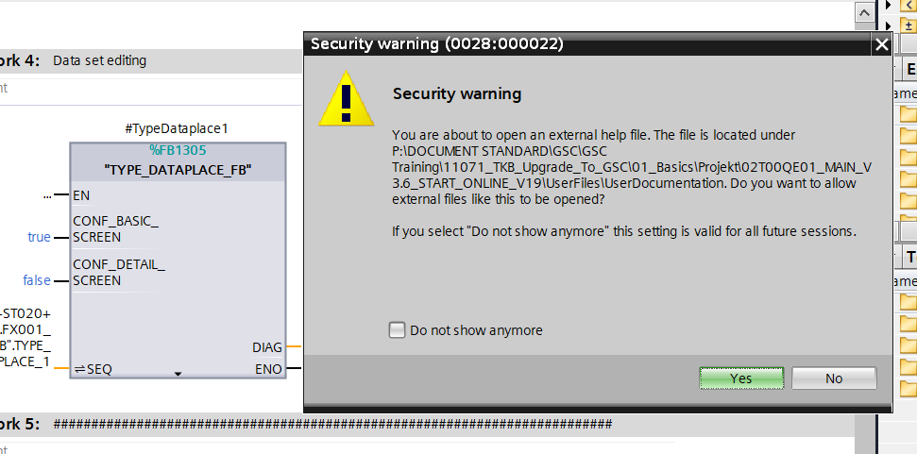
General information
Or we can go into the program, select a block, press Shift + F1 to find instructions related to that block.

Slide 4
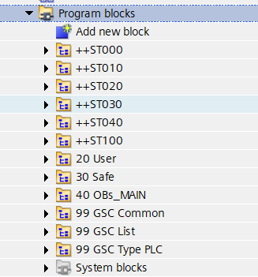
Structure
One folder per ST or FT
program
++ STxx / ++ FTxx
User blocks
20 users
All security components
30 safe
All OBs
40 Obs_MAIN
GSC data blocks
99 GSC Common
GSC message lists DBs
99 GSC list
GSC program module
99 GSC Type PLC
data types
User-defined PLC data types
20 USER
User-defined typed PLC data types
20 User Type PLC
GSC typed PLC data types
99 GSC Type PLC

Slide 5
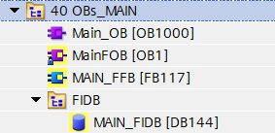
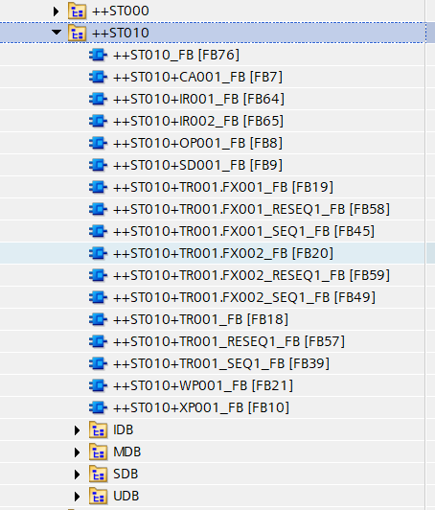
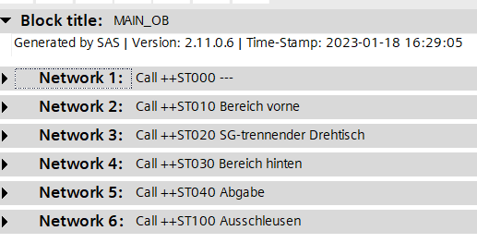
Structure
Main_OB is the component block that contains the functional blocks of each station
Each different station or FT has a Main_Block (for example: ST010_FB). Main block will call component blocks such as FX1, FX2, IR, OP, SD,.....

Slide 6
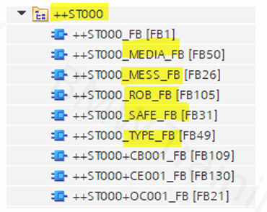
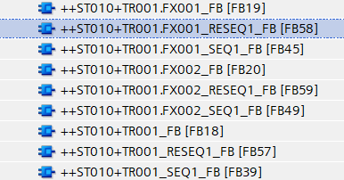
Structure
ST000 is called the main structure including blocks such as: Media(Diagnosis of component devices), Mess(Notifications during operation and errors), OC(Main Panel of ST000), Safe, Type,. ....
So there is the superimposed station ++ST000. Disturbances at this level affect the overall operating mode of the PLC. Faults in lower levels, such as in the ++ST010, only affect the operating mode area of the ++ST010.
The concept of fault inheritance is also reflected for the selection of the areas on
the HMI for manual operation
Different from the Sicar standard with fixtures or multi-sequence actuators, we will have 3 function blocks: FX0xx_FB (Main start), SEQxx_FB(automatic graph), RESEQxx_FB(Home position), with a complex structure using Functional blocks help the structure continue the cycle without needing to return to the beginning when there is a problem such as power outage, E-stop,...

Slide 7
Structure
DATA BLOCKS
building block | Theme | Description
MDS | MODE data | operating mode information
SDB / FSDB | SEQ data: | Connect standard blocks to graphs or related blocks
IDB / FIDB | INSTANCE data | instance data
UDB / FUDB | user data | Disallowed or temporary variables need to be used as initialization markers in the UDB

Slide 8
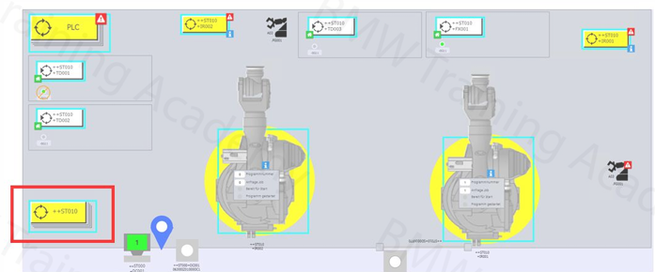
Structure
GROUPINGOFCOMPONENTS
As mentioned in the report on the TKB program, system levels such as LINE, PLC, SG, FG
Each ++ST0xx station is onegroup! An FG does notassigned to a groupautomatically through softwarestructure, but through clearlytasks in the programcode
We have the PLC level corresponding to ST000. All changes will be notified to Main_Sys_FB

Slide 9
Operating Modes
There are components WITH and WITHOUT operating modes. There are no operating mode ranges .
component | Reference AKZ_ | own operating mode | remark
Tool | FX001 TR001.FX001 | Yes | _
robot | IR001 | Yes | _
protective grille door | ++ST010+SD001 | no | _
worker place | ++ST010+WP001 | Yes | _
Each component with an operating mode has its own DB (MDB) for managing its specific data.
The MODE substructure manages all data relevant to the subject of operating modes .
IN / OUT area :
Is intended for the communication of the component to its subordinate blocks.
The communication is intended exclusively for standard blocks .
ONLY the OUT area may also be read in the user program

Slide 10
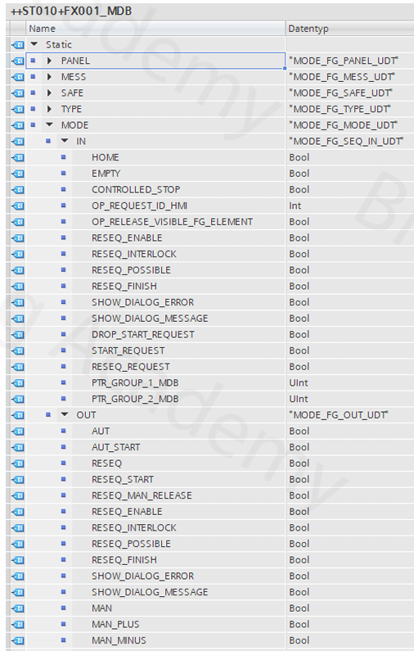
Operating Modes
In block ST010+FX001_MDB
Each component with an operating mode has its own DB (MDB) for managing its specific data.
The MODE substructure manages all data relevant to the subject of operating modes .

Slide 11
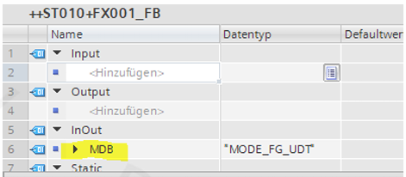
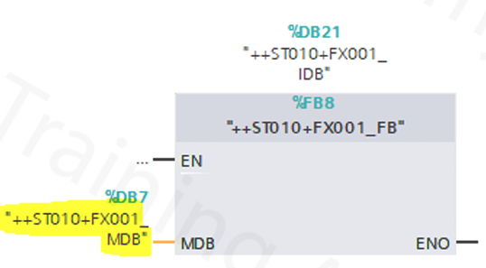
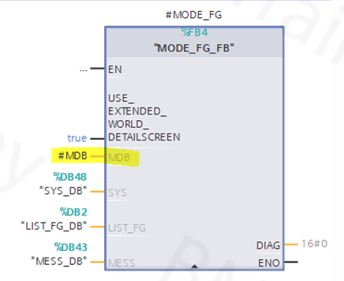
Operating Modes
The operating mode DB (MDB) is initially configured at the component block level and then propagated to the individual internally called blocks:
The parameter #MDB is set up as a hidden parameter on all blocks that necessitate it: MODE, DEV, SENS, etc.

Slide 12
Operating Modes
HANDLING OF THE OPERATING MODES
When Main_OB calls the ST010_FB block, it will check the mode of the devices currently in the MDB block, each device will respond the mode to its own MDB.
PLC_MDB
++ ST000_FB
MODE_PLC_FB
Main_OB
++ST010_MDB
++ST010+IR001_MDB
++ ST010+IR001_FB
++ ST010_FB
MODE_FG_GROUP_FB
MODE_FG_FB
MODE_FG_TO_GROUP_FB
...
++ST010+TR001_MDB
++
ST010+TR001_FB
MODE_FG_FB
MODE_FG_TO_GROUP_FB

Slide 13
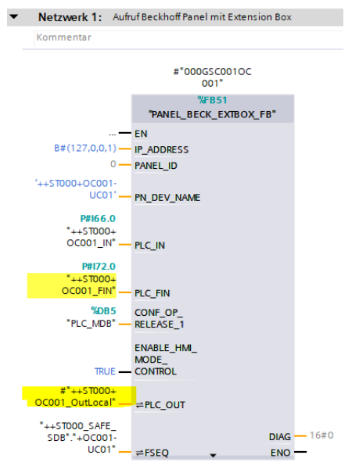
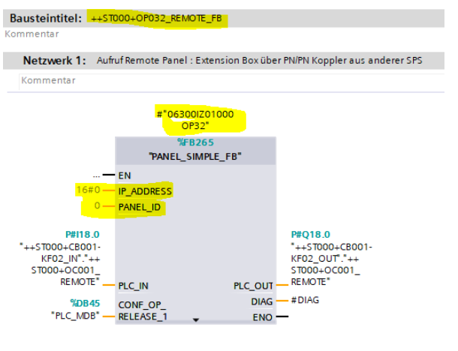
Operating Modes
Programming
For each Panel we need to determine the IP address based on Eplan and the corresponding PN_DEV_NAME to be able to accurately diagnose profinet.For CONF_OP_RELEASE, 1 OP can only manage 1 ST. If you want that panel to control other signals, you need to change the level to ST000.

Slide 14



Contact Us
LINK Group Headquarter
Shanghai, China
LINK Group North China
Shenyang, China
LINK Group Europe (LKGG GmbH)
Bad Reichenhall, Germany
Enquiry
Enquiry
Enquiry
ying.liu@LKautomation.com
kimi.wang@LKautomation.com
jackey.yin@LKautomation.com
+86 021 6918 0161
+86 021 6918 0161
+86 186 2171 9367
Sales
Sales
Sales
gene.zhang@LKautomation.com
gene.zhang@LKautomation.com
andreas.reymendt@LKautomation.com
+86 136 2179 1621
+86 136 2179 1621
Address
BLDG #D,North Jiasong Road No.3570 Jiading District,Shanghai,P.R.China
Address
NO. 14 22nd Floor,NO.168-3 Harbin Road,
Shenhe District,Shenyang,Liaoning
Province,P.R.China
Address
Fischerbraeuwiese 18b,83435 Bad
Reichenhall,Bavaria,Germany

